Slide 1
Arrays and Addressing Modes

Slide 2
Array Addressing
1D Array
.data
array dw 10,20,30,40,50,60
Array dw ?,?,?,?,?,?
X dw 100 dup(?)
Y dw 5, 4, 3 dup(2, 3 dup(0), 1)
5, 4 , 2, 0, 0, 0,1, 2, 0, 0, 0,1, 2, 0, 0, 0,1

Slide 3
Addressing Modes
The way an operand is specified

Slide 4
Types of Addressing Modes
Register Mode
When an operand is a register
Example: Mov Ax, Bx ; src & dest both in register mode
Immediate Mode
When an operand is a constant
Example : Mov AX, 1
Direct Mode
When an operand is a variable
Example: Mov Ax, C

Slide 5
Types of Addressing Modes(contd.)
Register Indirect
Offset address of an operand is contained in a register.
Offset : BX, SI, DI ; Segment # in DS
Offset: BP ; Segment # in SS
Example:
W dw 10, 20, 30
Mov ds, @data
Lea SI, W
Mov ax , [SI] ; ax 10
Add SI, 2 ; inc SI by 2 bytes/ 1 word as W is an word array
Mov ax, [SI] ; ax 20

Slide 6
Types of Addressing Modes(contd.)
Based /Indexed Addressing Mode
Array elements can be addressed in any of the following 4 ways:
Disp can be
[register + disp]
[disp + register]
[register] + disp
disp [register]
A variable
A constant
Variable + constant
Variable - constant
Ex . W
Ex . 2
Ex . W - 2
Ex . W + 2

Slide 7
Based/ Indexed Addressing Mode(contd.)
Example :
w dw 10, 20, 30, 40
Mov bx, 2
Mov ax, w[bx]
; interpreted as [w + bx], so ax = 20
; here disp[register] format has been used. All the 4 formats are interpreted as [ register + disp] or [disp + register]
; here w is disp and bx is register.
If BX or BP is used as register, then it is called Based Addressing Mode.
If DI or SI is used as register, then it is called Indexed Addressing Mode.

Slide 8
Based Indexed Addressing Mode
Elements can be addressed as:
Variable [BX or BP] [SI or DI]
[BX or BP] + [SI or DI] + variable + constant
Variable[BX or BP + SI or DI + constant]
Constant [BX or BP + SI or DI + variable]
Whatever the format, the address is summation of all components.
W dw 10, 20, 30, 40, 50 ; bx has 2, SI has 4
Mov ax, w[BX + SI] ; ax = 40
Mov ax, w[BX + SI + 2] ; ax = 50

Slide 9
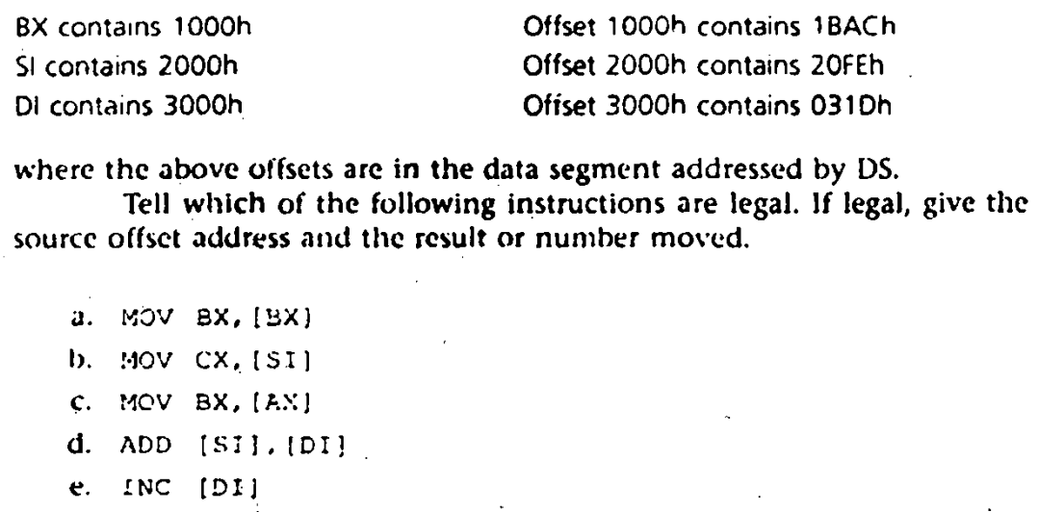
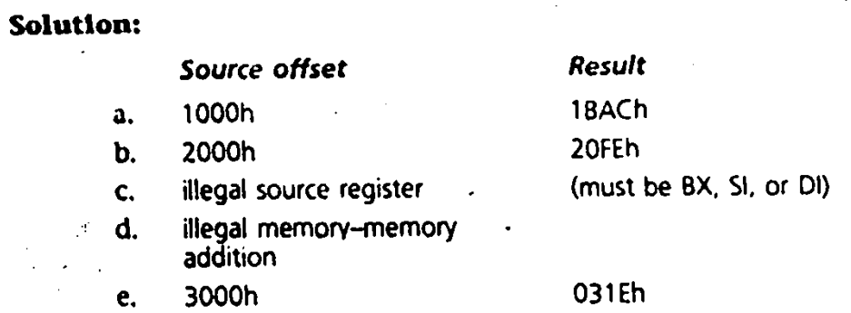
Exercise (1)

Slide 10
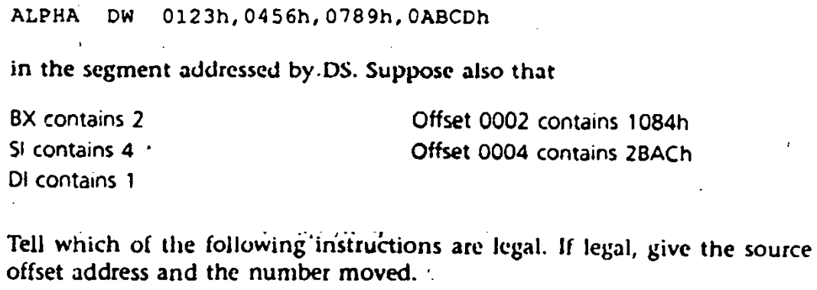
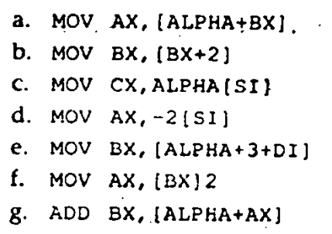
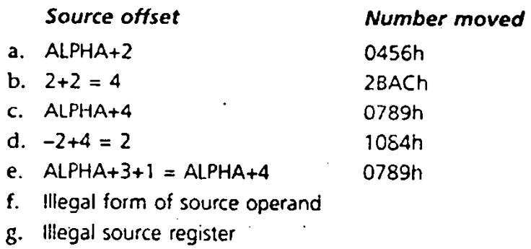
Exercise (2)

Slide 11
Exercise (Try yourself)
Sum of array elements
Reverse an array
Sort an array (ascending/descending)

Slide 12
Array Addressing : 2D Array
B dw 10, 20, 30, 40
dw 50, 60, 70, 80
dw 90, 100, 110, 120

Slide 13
2D Array (contd.)
If A is an MxN array; element size s byte
A[i,j] has address: A + ((i-1)xN + (j-1)) x S

